Slide 1
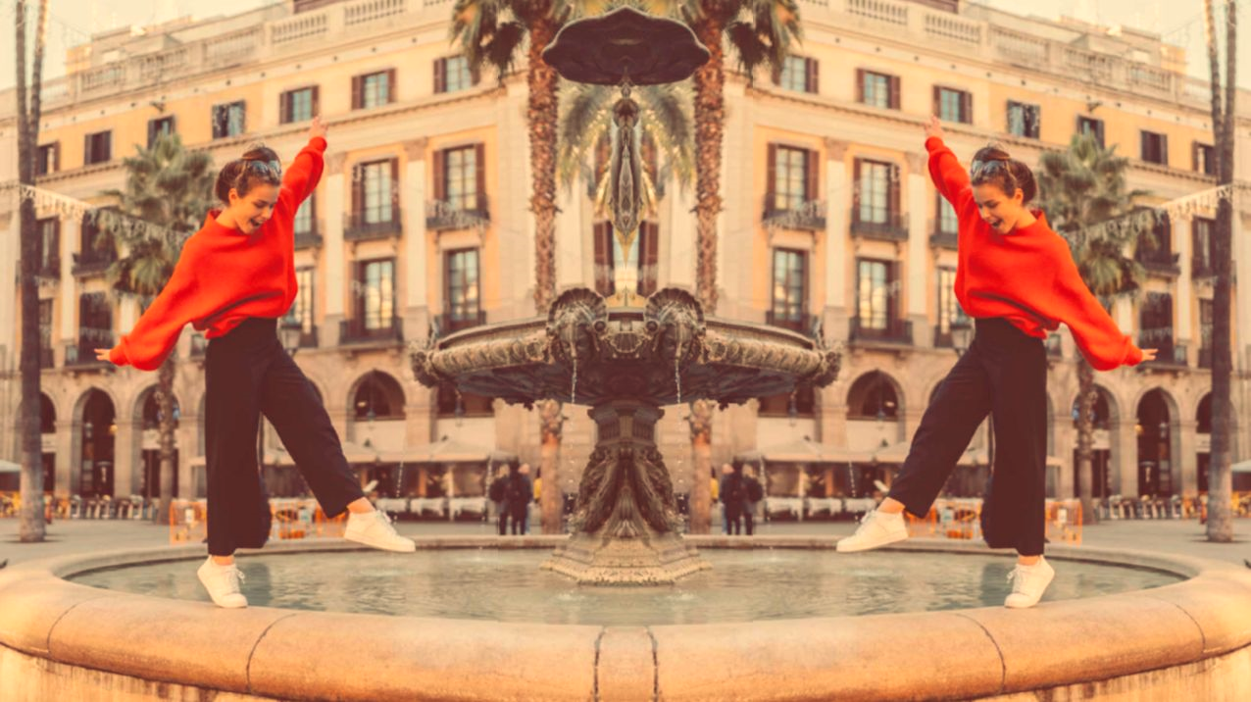
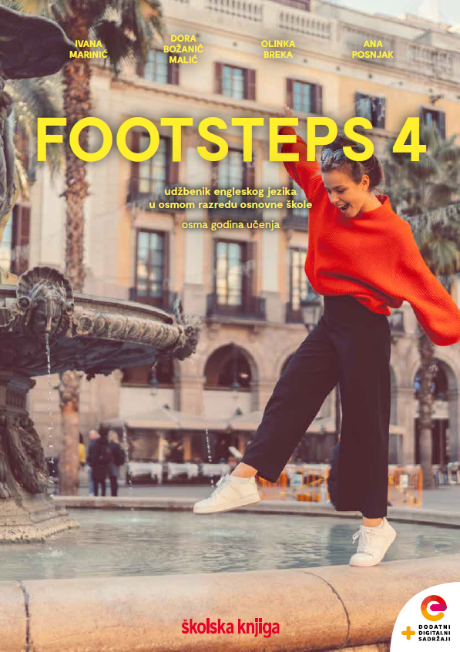

UNIT 1;
All too human
Self-check 1

Slide 2
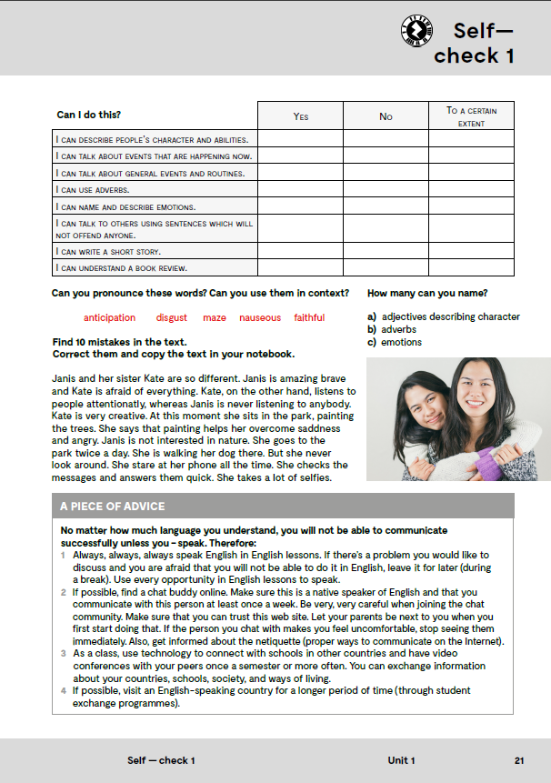
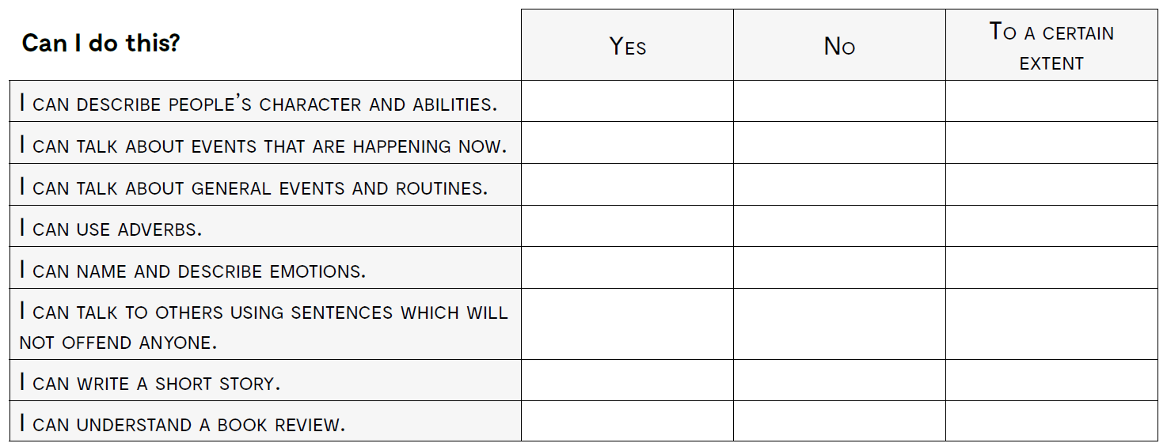
opisati karakter i sposobnosti osobe
razgovarati o događajima koji se događaju sada
govoriti o navikama i rutinama
koristiti prijedloge
imenovati i opisati osjećaje
govoriti o drugima koristeći rečenice i izraze koji ih neće uvrijediti
napisati kratku priču
razumjeti književnu kritiku

Slide 3
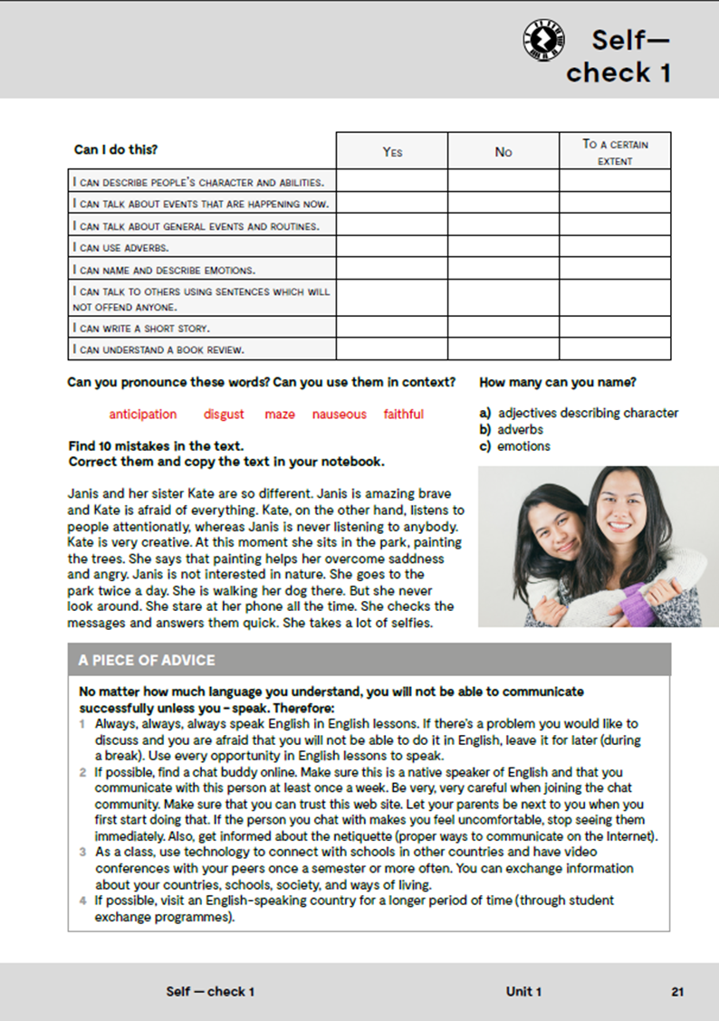
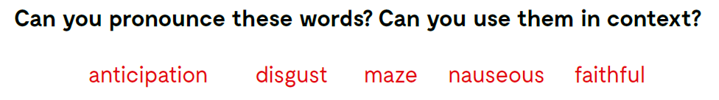
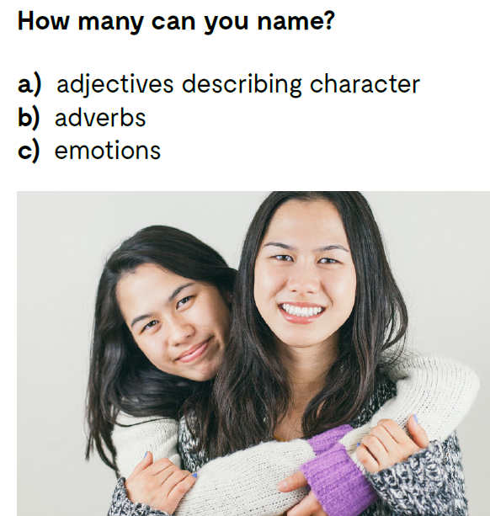
Can you pronounce these words? Can you use them in context?
How many can you
name?
adjectives describing
character
pridjeva koji opisuju
karakter
adverbs
priloga
emotions
osjećaja

Slide 4
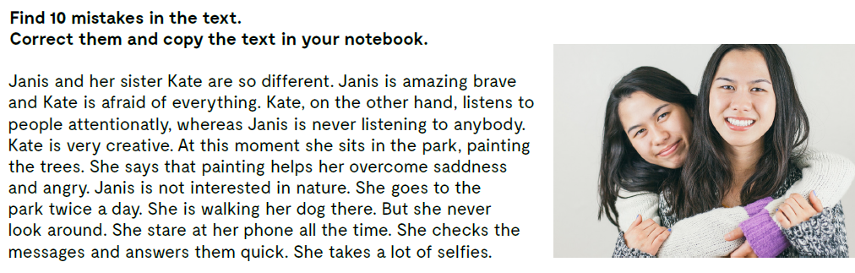
Find 10 mistakes in the text. Correct them and copy the text in your notebook.
Janis and her sister Kate are so different. Janis is amazingly brave and Kate is afraid of everything.
Kate, on the other hand, listens to people attentively,
whereas Janis never listens to anybody. Kate is very creative.
At this moment she is sitting in the park, painting the trees.
She says that painting helps her overcome sadness
and anger. Janis is not interested in nature. She goes to the park twice a day.
She walks her dog there.
But she never looks around.
She stares at her phone all the time.
She checks the messages and answers them quickly. She takes a lot of selfies.

Slide 5
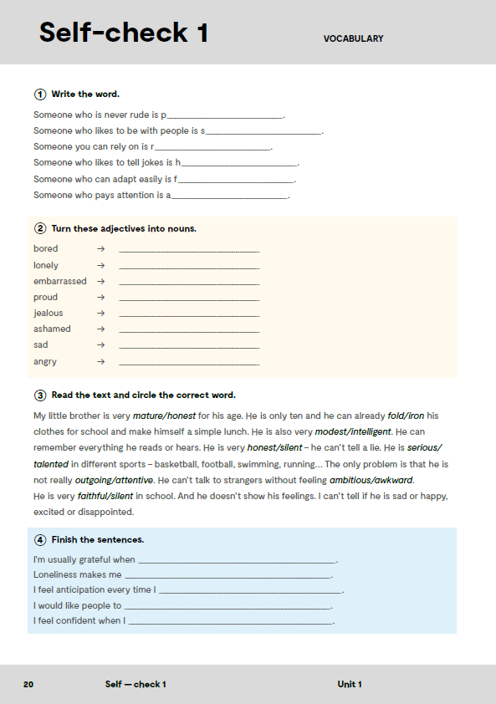
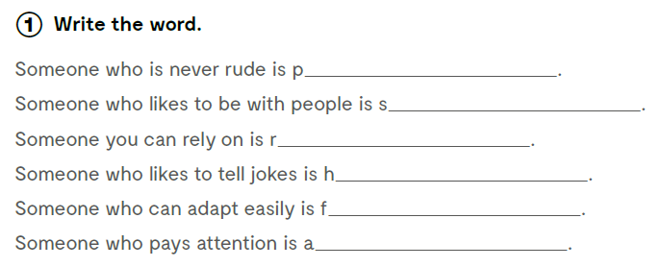
olite
ociable
eliable
umorous
lexible
ttentive

Slide 6
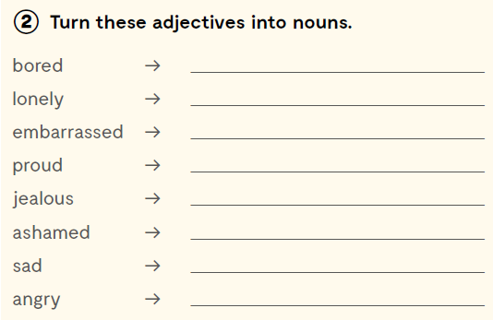
Turn these adjectives into nouns. Pretvori pridjeve u imenice.
boredom
loneliness
embarrassment
pride
jealousy
shame
sadness
anger
Check what you have learnt:
Provjeri koliko si naučio:
https://wordwall.net/play/11722/408/915

Slide 7
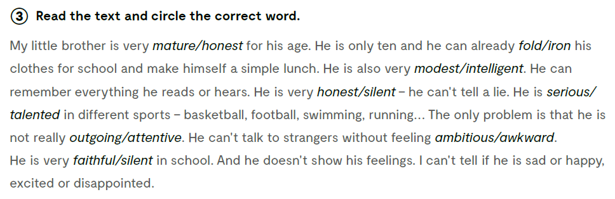

Read the text and circle the correct word.

Slide 8
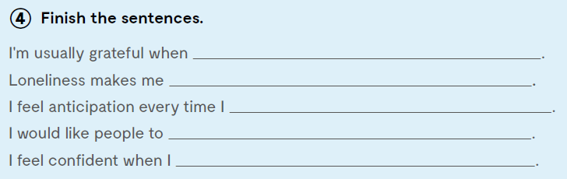
Finish the sentences.

Slide 9
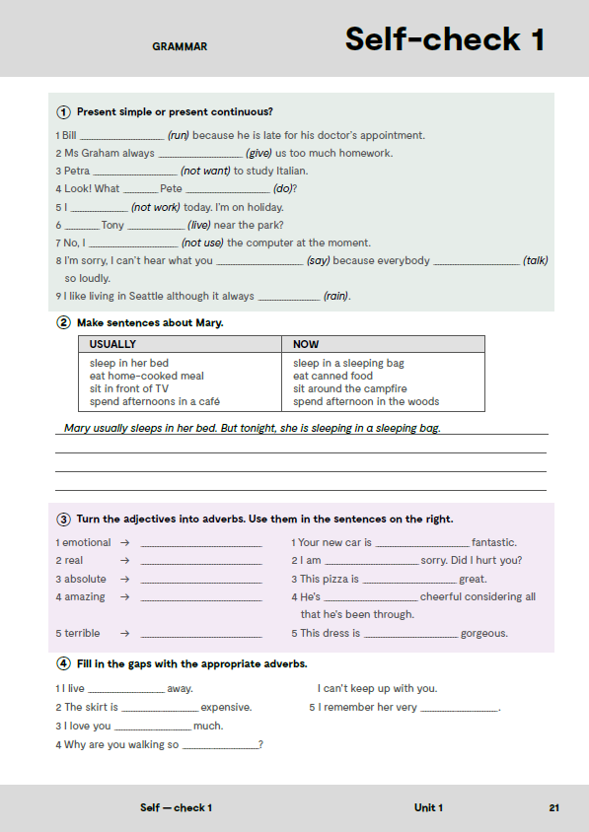
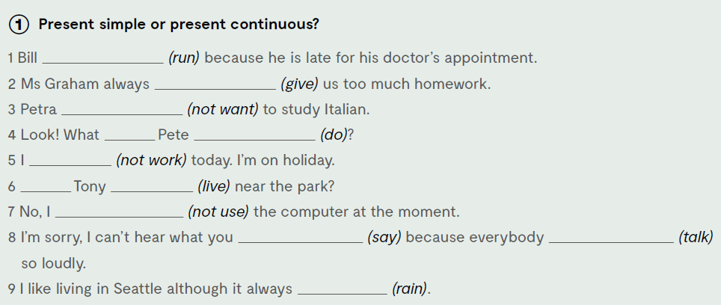
In task 1, on the next page of your exercise book choose the correct tense. Present Simple or Present Continuous?
is running
gives
doesn’t want
is doing
‘m not working
Does live
am not using
are saying
is talking
rains

Slide 10
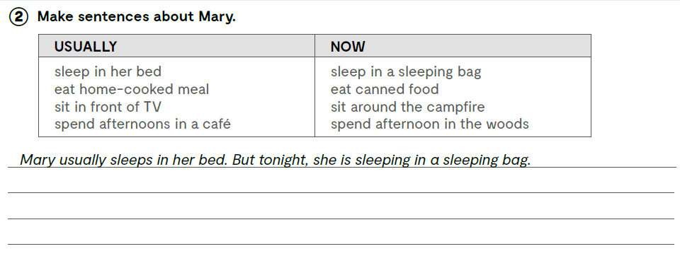
Make sentences about Mary. Napiši rečenice o Mary.
Mary usually eats home-cooked meal. But tonight, she is eating canned food.
Mary usually sits in front of TV. But tonight, she is sitting around the campfire.
Mary usually spends afternoons in a cafe. But today, she is spending afternoon in the woods.

Slide 11
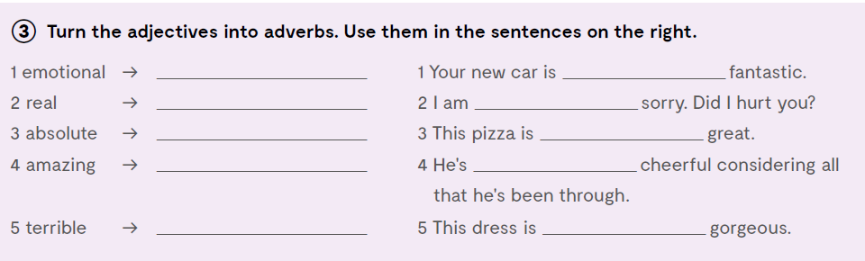
Turn the adjectives into adverbs. Use them in the sentences on the right.
emotionally
absolutely
really
terribly
absolutely
really
amazingly
emotionally
terribly
amazingly

Slide 12
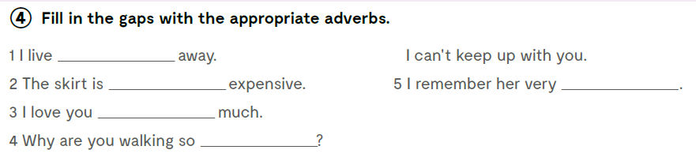
Fill in the gaps with the appropriate adverbs.

Slide 13
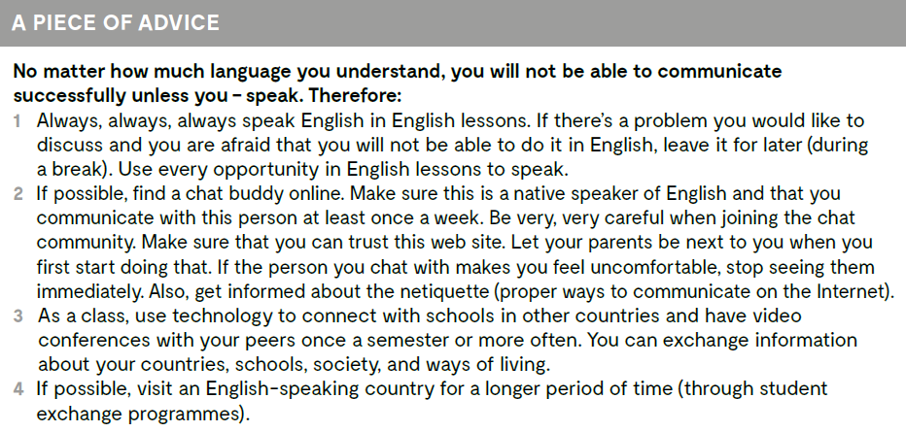
Take a look at this piece of advice on how to improve your English! No matter how much language you understand, you will not be able to communicate successfully unless you – speak.

